Slide 1
Mutex Try Lock
08/01/2021

Slide 2
General Info
TRIES to lock the mutex (may not work if something else has already locked the mutex)
Returns IMMEDIATELY - won’t ever get blocked (non-blocking)
If ty_lock is called again by the same thread which owns the mutex, it’s an undefined situation (DONT DO THIS)
Deadlock situation may be caused, if we want to lock a mutex more than once by a thread, we can use recursive_mutex

Slide 3
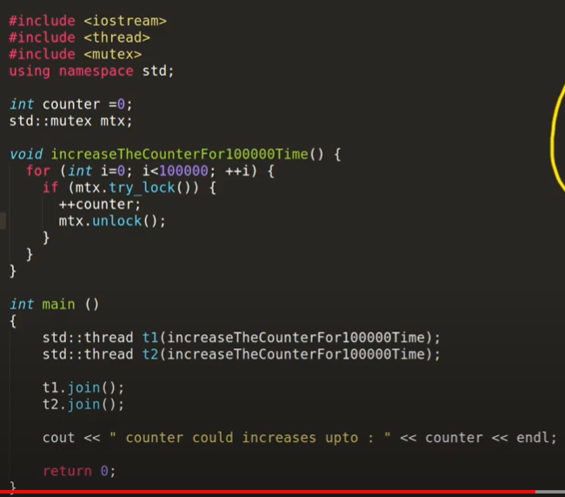
What does this do?
There are two threads that are reaching the function
If thread 1 gets there first, and t1 increments the counter, t2 cannot get the lock so it returns false and DOES NOT go into a blocked state
As we dont wait for t1 or t2 to complete, some numbers in the 200000 might be skipped so you get random numbers (less than 200000)
How do we fix this if needed?

Slide 4
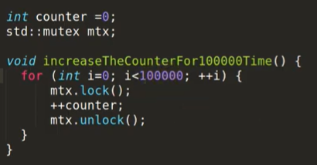
Lock vs Try Lock
Locking the mutex rather than trying to lock it leads to each thread to wait for the other to finish and we will get 200000 as a result every time

